Slide 1
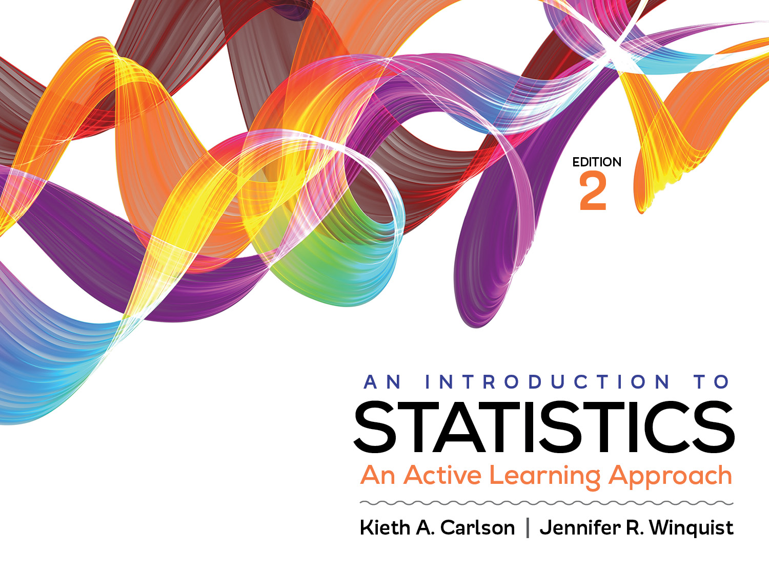
Introduction to Activity 9.2
Combining significance testing, effect sizes, and confidence intervals

Slide 2
Activity 9.2 will require you to:
Compute and interpret a related samples significance test, effect size, and 95% confidence interval for the same research scenario
Integrate all three statistical procedures into APA style summaries
Create and interpret SPSS output for all three statistical procedures

Slide 3
Purposes of statistical procedures
Statistical procedure | Purpose
Significance testing | Decide if a treatment worked Determine if result is likely due to sampling error
Effect size | Describe how well a treatment worked
Confidence interval | Estimate a population parameter

Slide 4
Where to put the statistical information in APA summaries
The post tutoring exam scores (M = 50, SD = 10; _______) were significantly higher than the pre tutoring scores (M = 45, SD = 10; _______), ____________ , _________, _________, _________.
CI [1.03, 8.57]
t (99) = 2.5
d = 1
95% CI [48.02, 51.98]
CI [43.02, 46.98]
p < .05
Place each of the statistical values to the left in the appropriate spot in this APA style write up.
Notes:
95% CI [48.02, 51.98]; CI [43.02, 46.98]; t (99) = 2.5; p < .05; d = 1; CI [1.03, 8.57]

